Slide 1

Farmezee
BLACKBOX
Blockchain solutions for Agro - FinTech
Team

Slide 2
Abstract
An organization that develops, upgrades and manages a blockchain based crypto currency network that is completely Farmer-centric. The main motto is to introduce the farmers to a digitized currency and decide the cost of their goods by themselves like manufacturers do whilst eliminating the middleman costs for sales by carrying it out through our user-friendly web interface and reducing the transportation costs.
An Online Credit based currency system similar to that of cryptocurrency. The users can buy the FarmEzee currency called Farmico that gets its value on the fluctuating demands of the currency and on the values of goods set by the farmers.
Easier International transactions for the farmers with the globalized farmer’s currency – Farmico and hence reducing the fund transfer duties taken buy various brokers and middlemen.
Motive / Goal : Enable access for the farmers to the world of digital currency where they can set the market value of their goods and services and huge industrialists do for their products and reduce the amount of payment frauds happening with the farmers by using the blockchain method of storing transactions where manipulation (overwriting) of data is not possible by fraudulence parties.

Slide 3
Major Features
Farmico Digital Currency.
Web Based Agriculture Market
Integrated Transportation Facilities

Slide 4
Farmico Currency
A credit based digital currency.
Users have to buy it from the portal and cryptocurrency is bought using actual money transfer.
Certain amount of credits (Farmico) equivalent to the money invested will be transferred into the wallet in your FarmEzee Login.
These credits can be used to buy goods from farmers from anywhere in the world and once the order is placed the Order-worth of Farmicos will be transferred to the Farmers Account.
The Farmer can then redeem the Farmico into actual money within a certain period of time after which the Farmer’s account will be automatically credited with the equivalent value of actual mony based on the value of Farmico that time, so that Farmer can carry out the daily expenses using that amount.
The Value of Farmico depends on the demand of Farmico in the market i.e., if the demand increases the value increases also if the value of shares increases the value of Farmico also increases with it and vice versa.

Slide 5
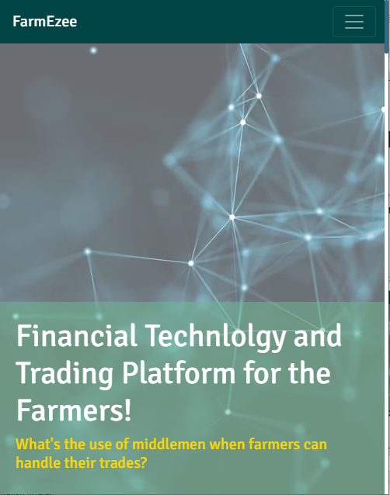
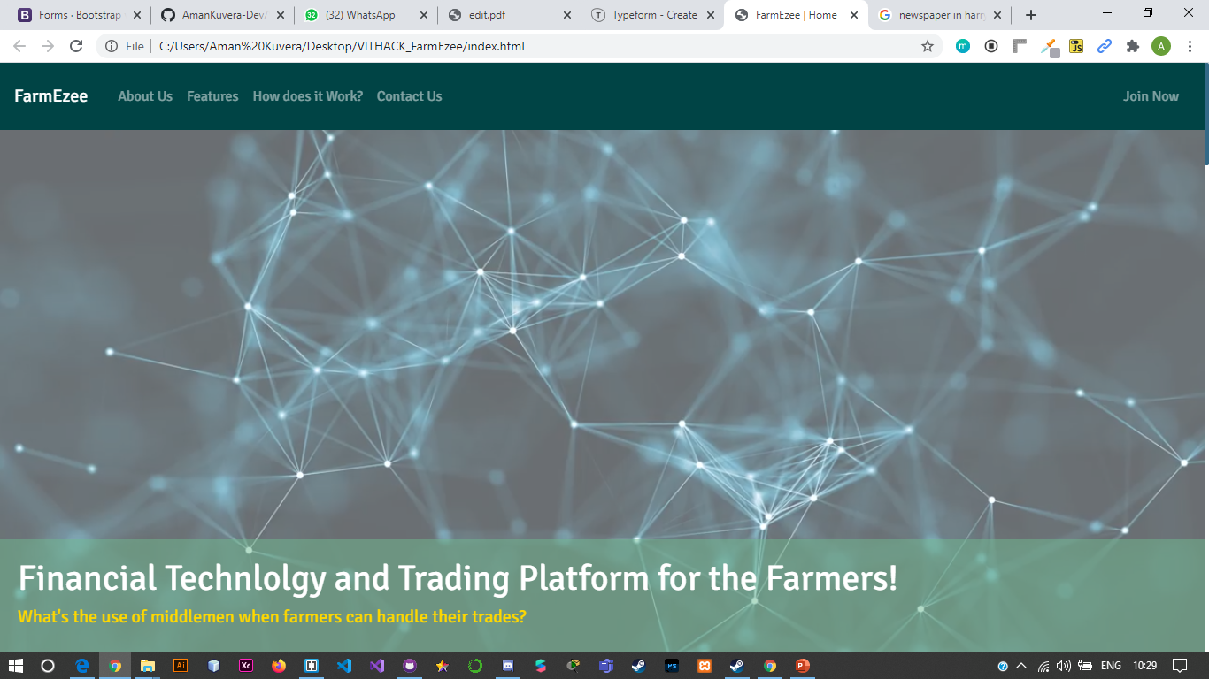
Web Platform - FarmEzee
The main idea is to create the E-commerce model but for Agriculture where individual farmers are the retailers and they decide the rising and falling of prices for their goods and no other has the right to do it for them. Therefore, providing a means of power to the farmer for getting the worth of their work.
Sub Features:
Responsive UI –

Slide 6
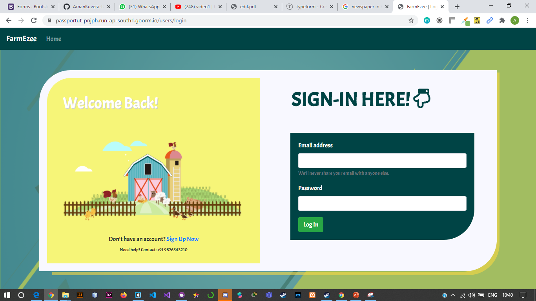
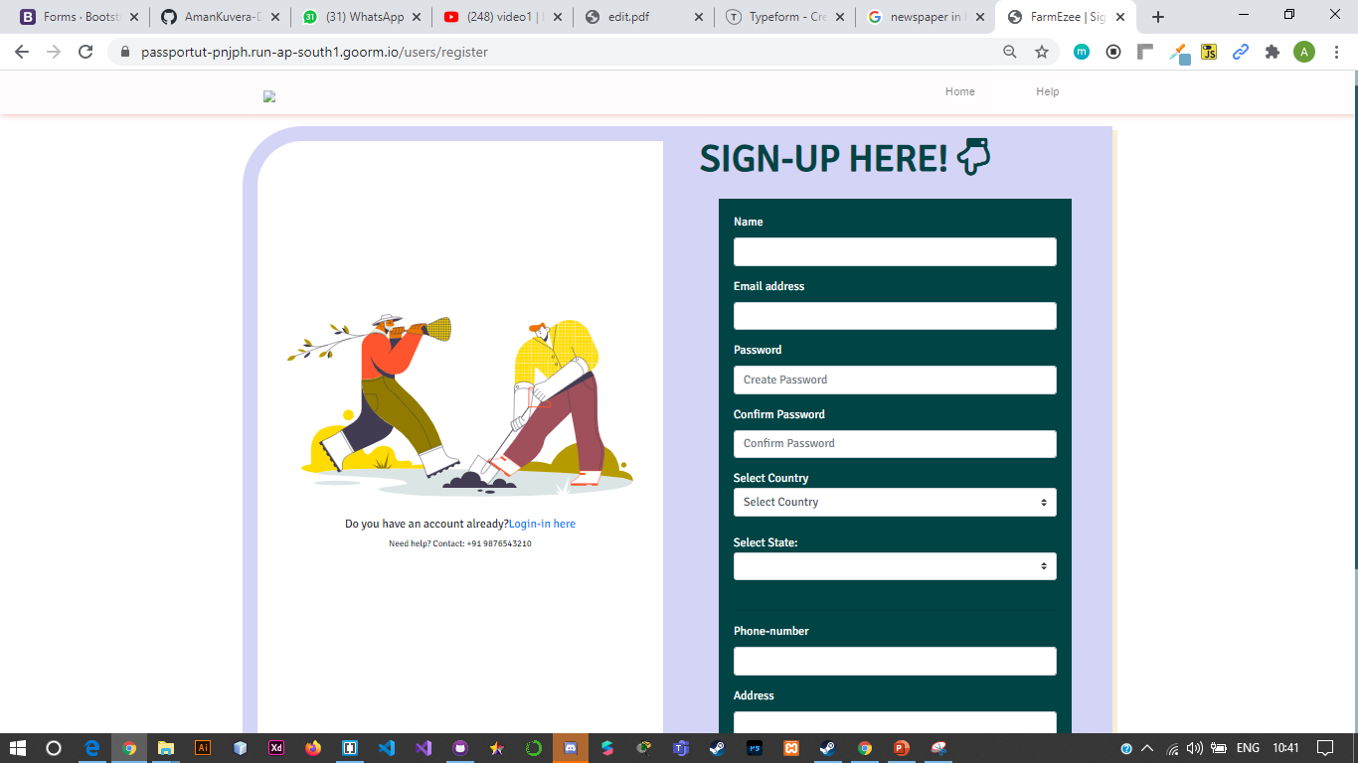
Sign In and Sign Up portals for both Farmer and Consumers

Slide 7
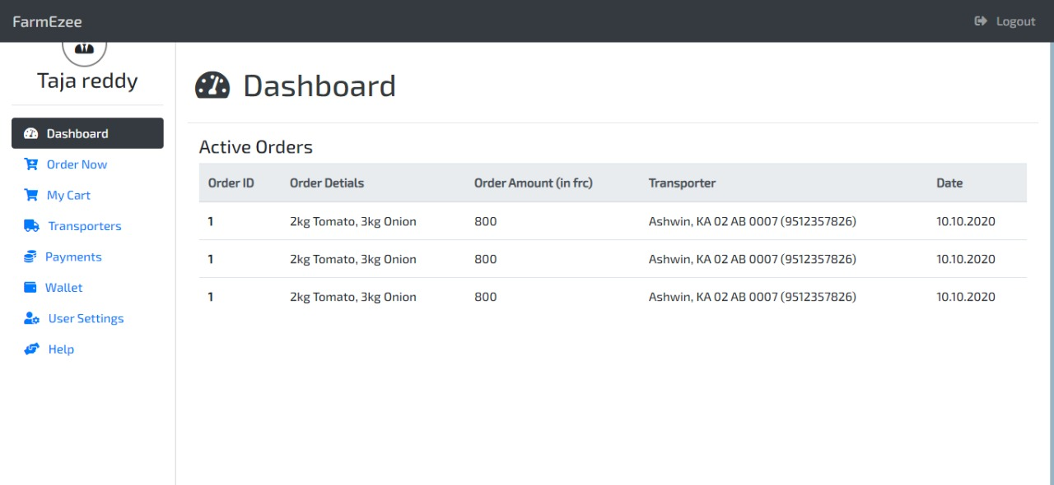
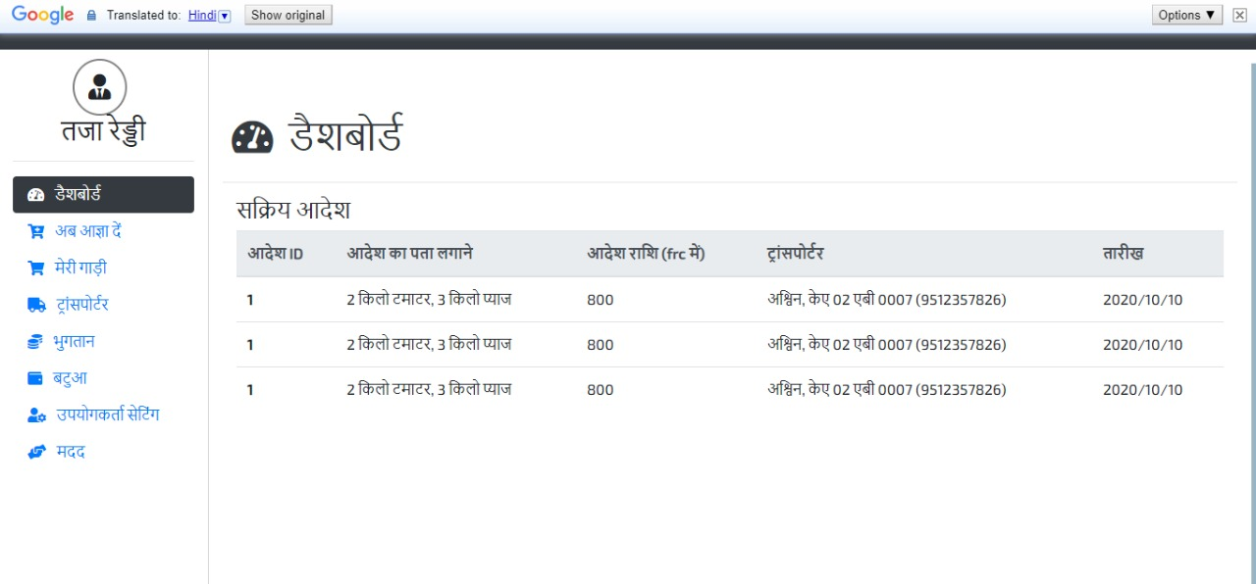
Multi-lingual Web UI powered by Google API –

Slide 8
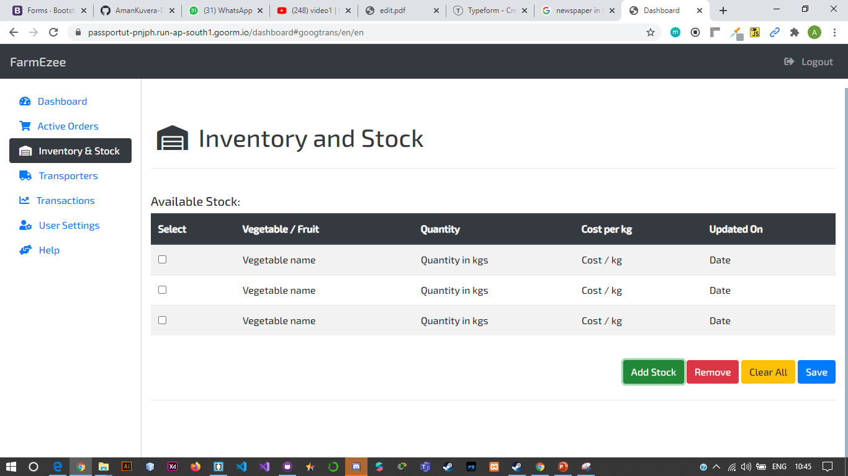
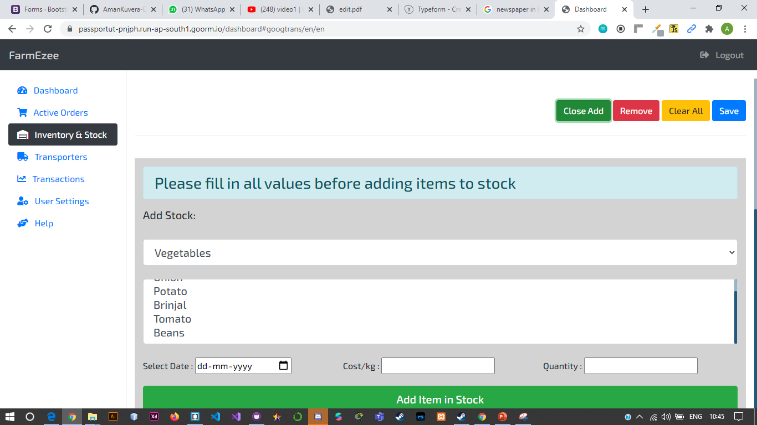
Add and remove stock and goods (Inventory Management for Farmers)

Slide 9
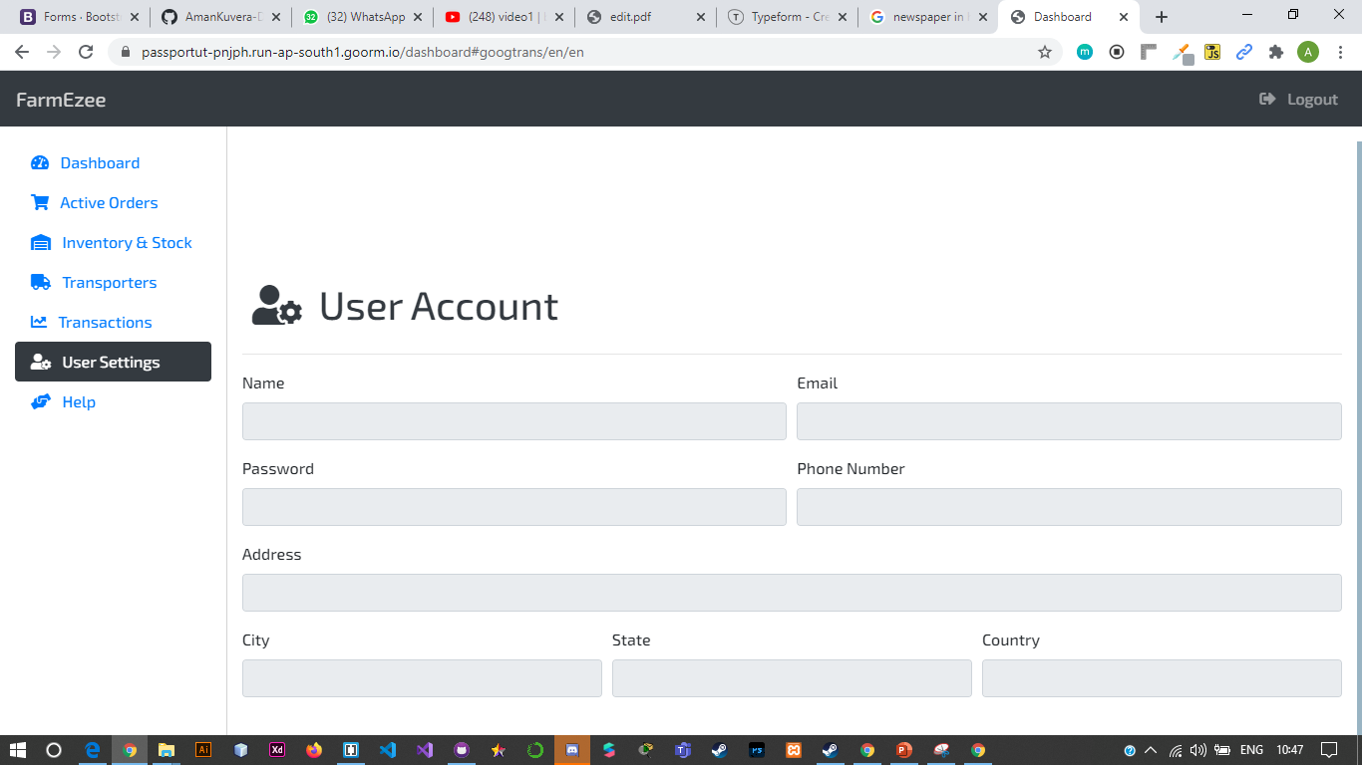
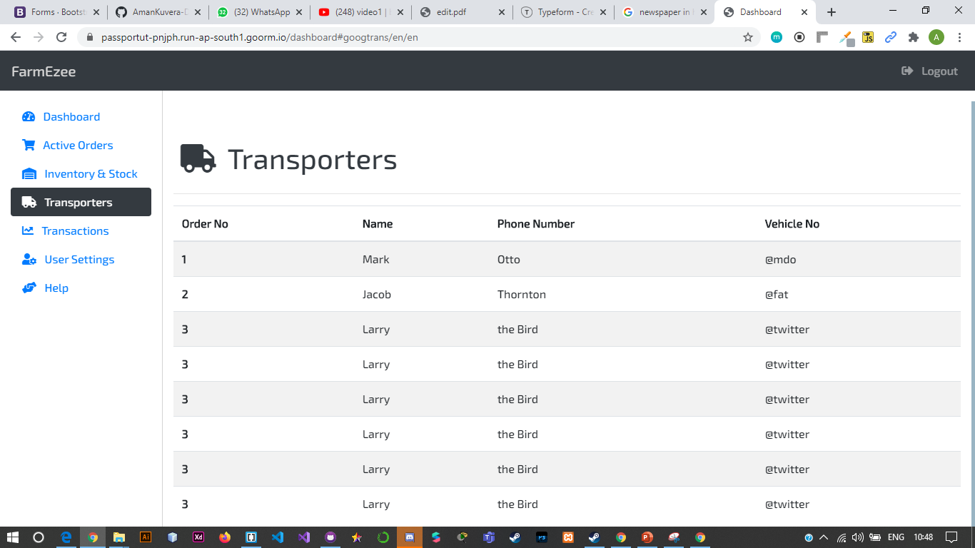
User account management and transporters database

Slide 10
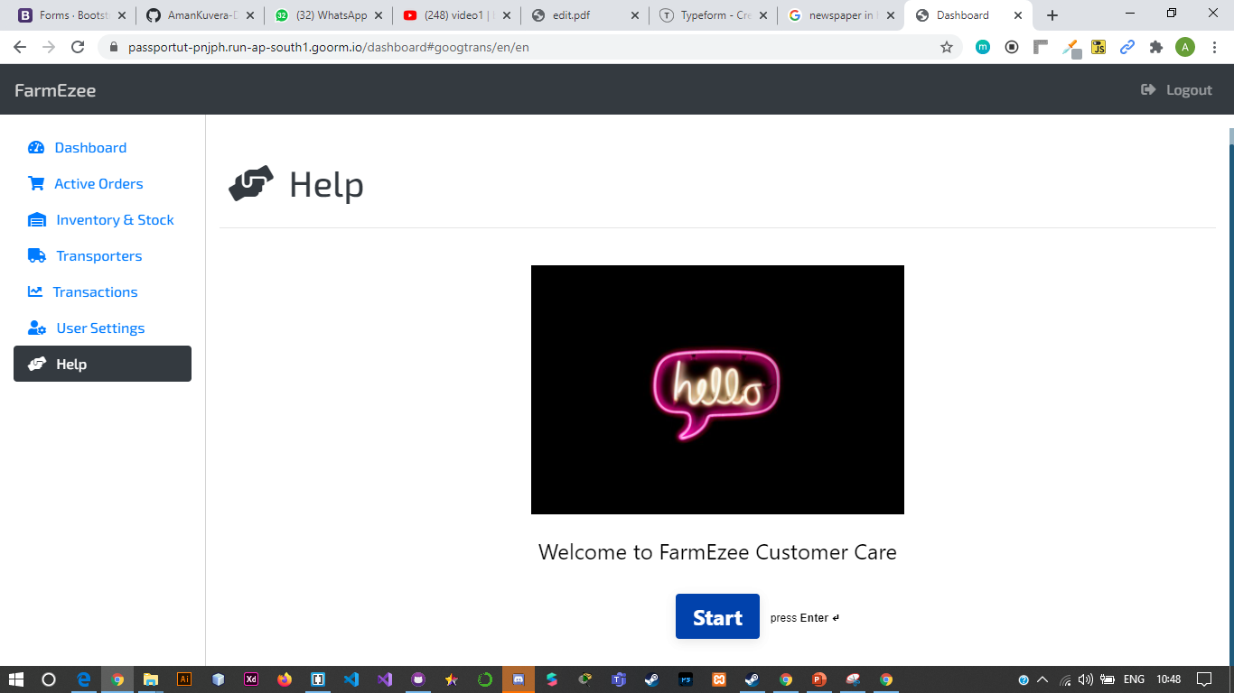
Integrated TypeForm for help and queries submission

Slide 11
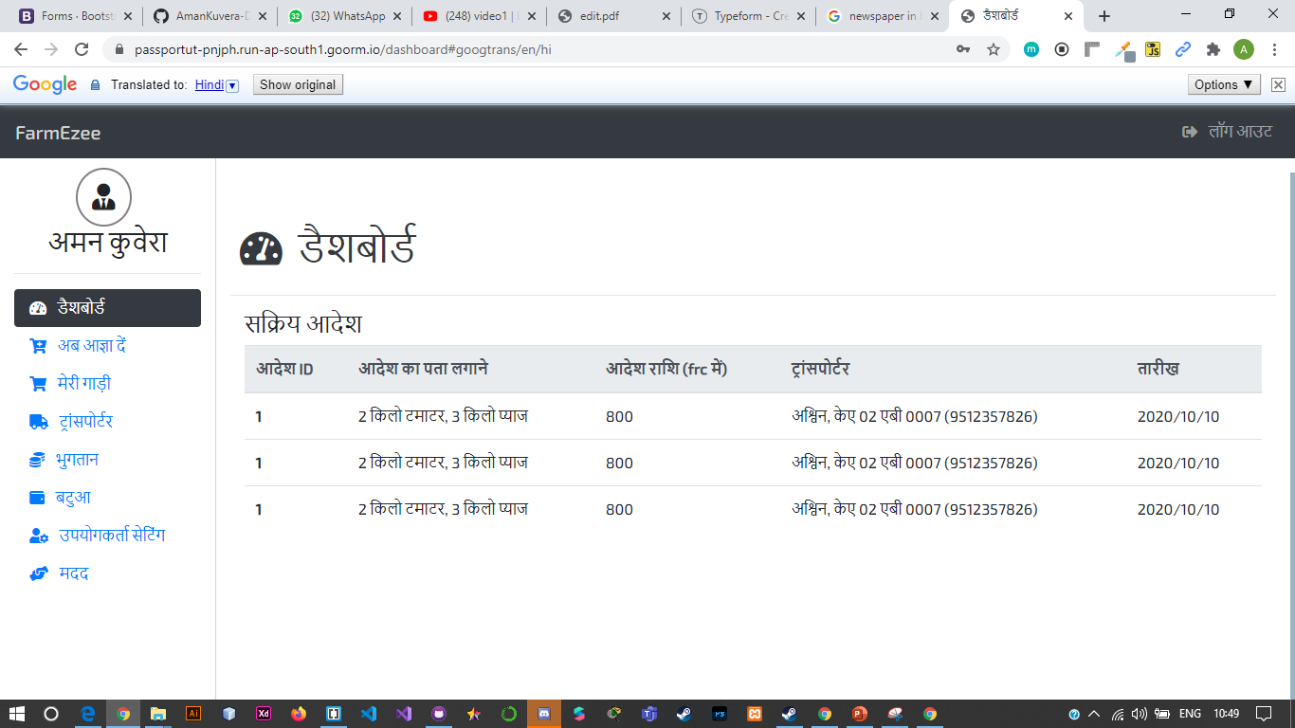
Consumer Portal

Slide 12
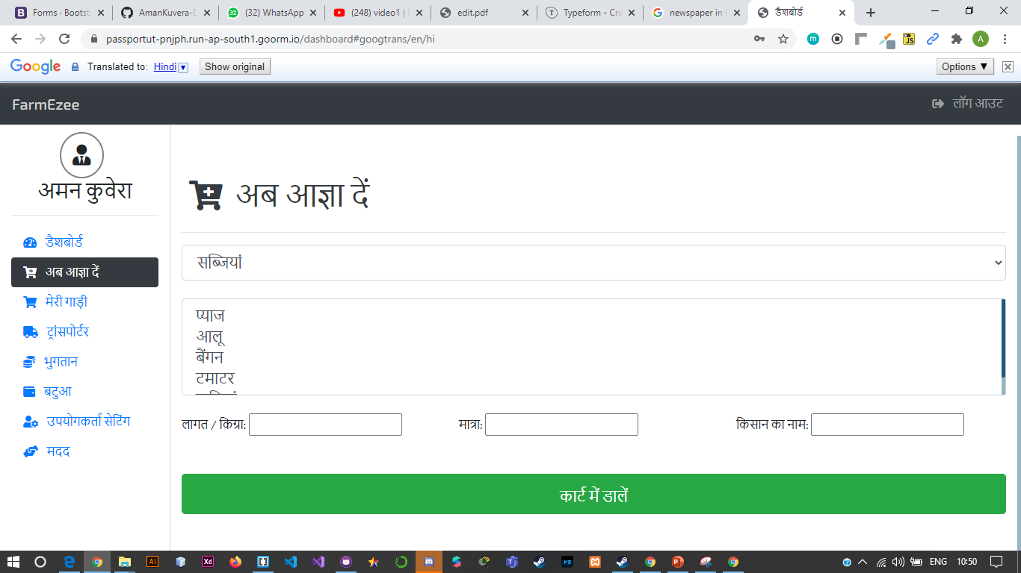
Place Orders

Slide 13
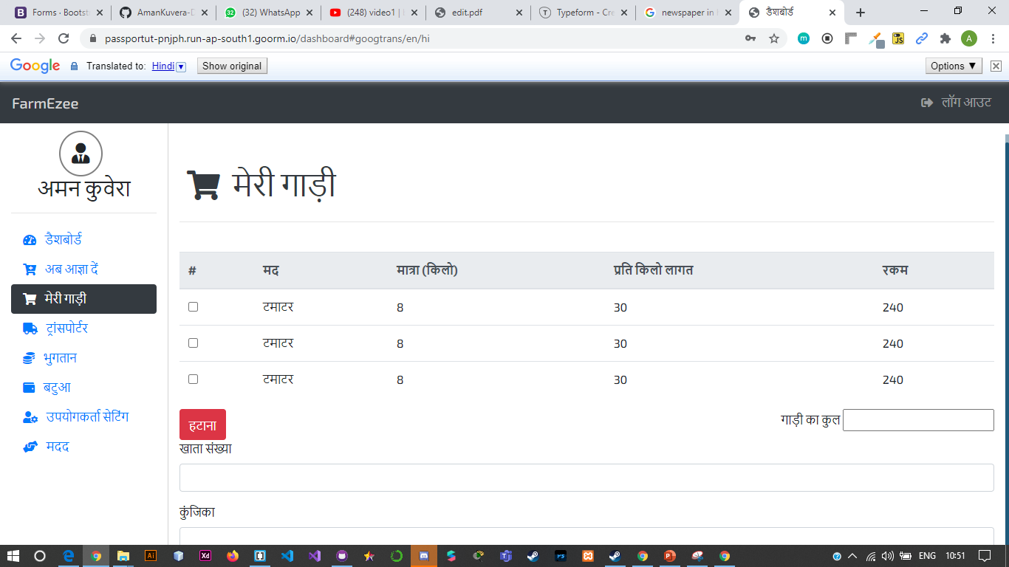
My Cart (selected items) and Payment:

Slide 14
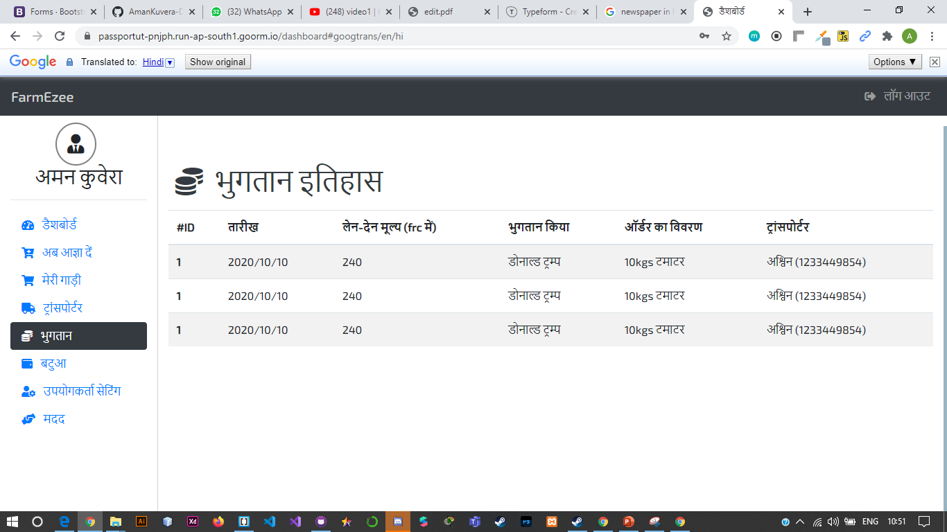
Transaction history

Slide 15
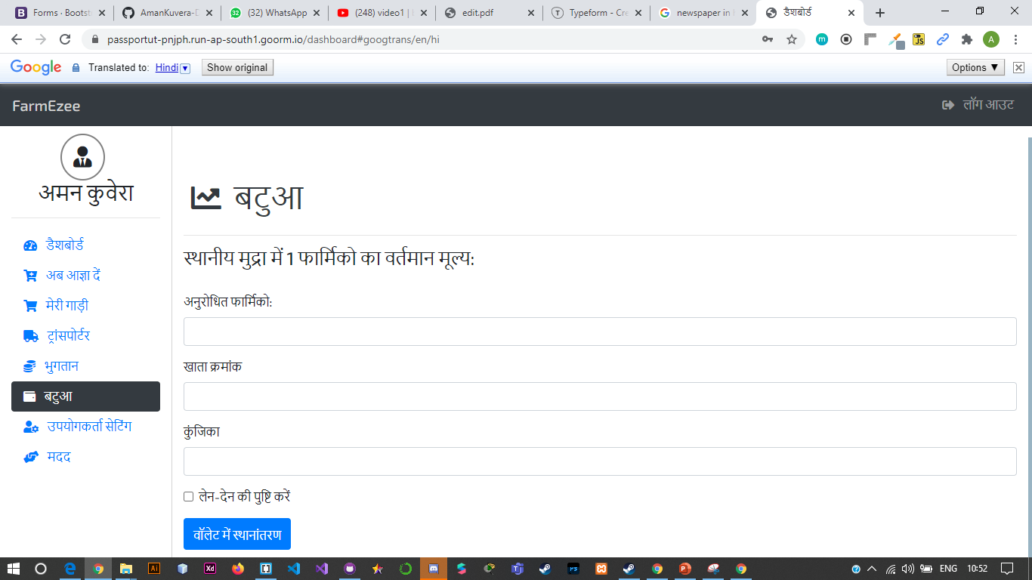
Buy Farmicos

Slide 16
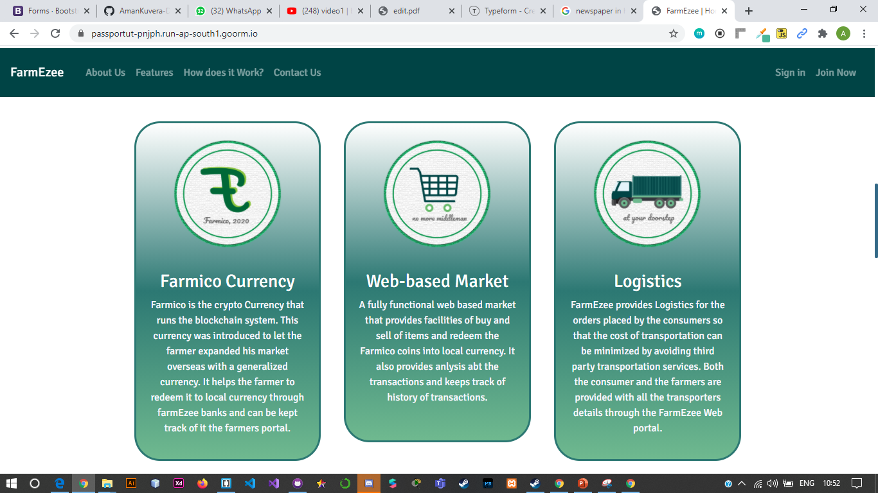
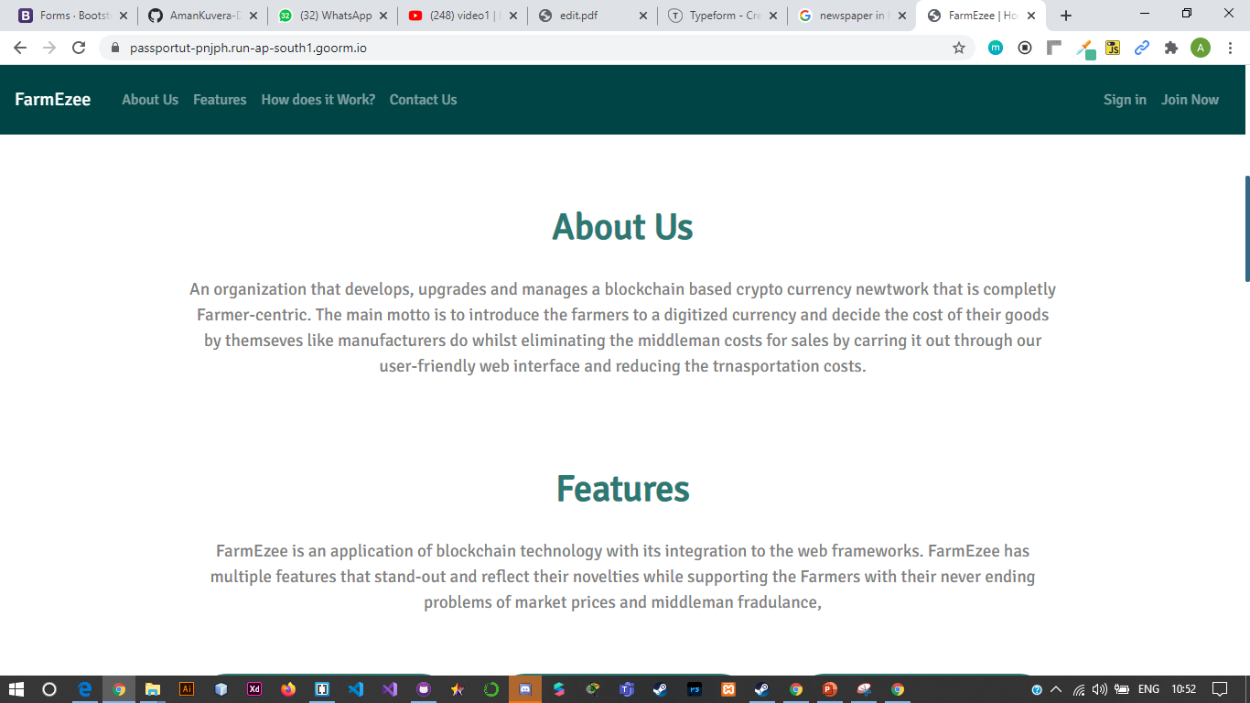
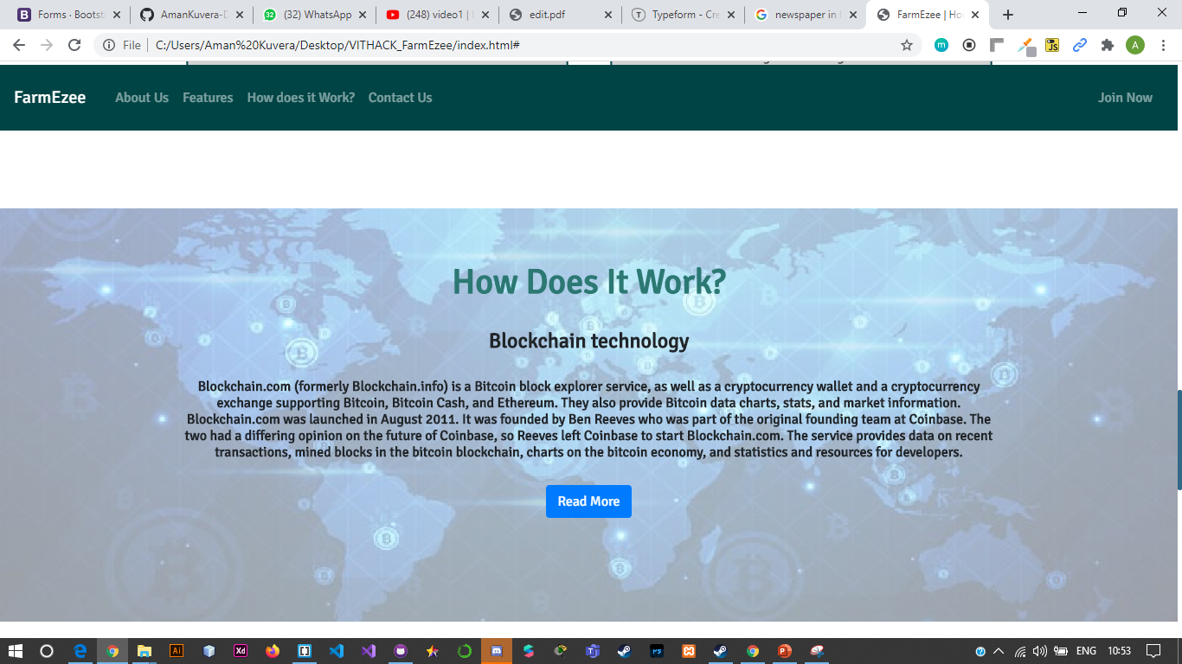
Attractive Web UI

Slide 17
Thank You – Do share the Feedback
Links:
https://youtu.be/puRoyBMnBNY
https://passportut-pnjph.run-ap-south1.goorm.io/
https://goor.me/uTRLb -project link (open the project and run node app.js)

